Slide 1
Web Technology
Third Year Engineering
UNIT-I
Basics of Web Technology Programming using HTML

Slide 2
HTML
Content:
World Wide web
Difference Between HTTP& HTTPs
Difference Between HTML4& HTML5
HTML Introduction
HTML Elements

Slide 3
Connect
to
the
World!
Internet and the World Wide Web:
The Basics
Thousand Oaks Library

Slide 4
A
Network
of
Networks
The Internet is the largest group of
computers ever linked together.

Slide 5
Network of Computers -
Serving out Information

Slide 6


Structure and Nature of Internet- What is Internet?
The Internet is a large network of systems interconnected with each other. Internet offers a
variety of services and tools.
Today, people across the world interchange lot of information called ‘data’ using the Internet. The
most common uses of the
information, etc.
Internet are
sending and receiving e-mails, chatting, searching
for
Terms you should know:
Intranet:
Extranet:
An Intranet is the private networking
system within an organization. You can simply define it as a private
An Extranet is actually an Intranet
that
is
partially
accessible to
authorized outsiders. Simply, it is an
internet. Intranet serves as
powerful
extended Intranet
to the
users
tool
of
communication
in
an
outside an organization. People who
are not related to the organization cannot access the information.
organization.

Slide 7
A brief history of the internet
1957: Sputnik launched, US creates DARPA
1969: ARPANET goes online
(UCLA, Stanford, UCSB, University of Utah)
•
•
•
•
•
•
•
•
•
•
1972:
1973:
1979:
1988:
1990:
1992:
1999:
2005:
Email adapted for internet
TCP/IP protocols developed
USENET started
First T1 lines become the internet
ARPANET taken out of service
World Wide Web
Wi-fi standardized
backbone
One Laptop Per Child Project begins

Slide 8
The Internet’s Major
The World Wide Web
Electronic mail
News
File Transfer Protocol
Chat
Instant messaging
Online services
Peer-to-peer services
Services
▪
▪
▪
▪
▪
▪
▪
▪
14

Slide 9
Differences in Internet and World Wide Web
Internet : The Internet is
– a network of networks
– Information travels over the Internet, via a protocols (TCP/IP)
The World Wide Web, (popularly known as web) is
– the way of accessing information over the medium of the Internet.
– the model of sharing information and that's why is sits on the of the Internet

Slide 10
Web Architecture
Why architect the Web Applications?
What is N "Tier“ architecture?
Notes:
Usually developers would like to attack the programming as soon as they encounter a
problem.
We must realize there is lot more to programming than simple coding.
Coding web-application without architecting it can result in critical problems at the later stage
because Web applications run under environments like browser, web servers , application
servers and they communicate using specific protocols like HTTP
One can compare this to building a huge complex without involving a good architect or by bypassing
the Architecture stage.
The architecture is the winning factor of the web-application ( which might become the losing
factor if not handled properly).
In this course we will talk about architecting the Web applications and the importance of the
same.
What is usual N “Tier” architecture of Web applications?
In an web application, usually the terms tier and layer are used interchangeably.
N "Tier” architecture can be defined as two or more levels arranged one above another
where each level serving distinct and separate tasks like presentation, business logic, data
access etc.
Any number of such levels (or tiers) can be arranged above another.
Web Applications usually use N-tier architecture because it provides a model for flexible
/reusable/ maintainable application.
By breaking up a system into tiers, developers only have to modify or add a specific tier,
rather than rewriting the whole application
, if a particular tier (say database) needs change or if the application needs to scale up.
An example for the same in real –life is that a CAR is more scalable than 3 wheeler which is
more scalable than a Bi-Cycle.

Slide 11
N “Tier” Architecture
Data Tier
also known as back end tier
• The Presentation Tier
– also known as front end tier
• The Business Logic Tier
– also known as brain of the application
Notes:
Data Tier: Is always a part of Web-application.
Though System can exist without data tiers, all real-life examples explicitly need a data tier
to handle the complex requirements of data storage.
This layer is the Database Management System (usually RDBMS).
It can be very complex like a high-end product (Oracle/SQL Server), which do include
features like backups/recovery/query optimization etc.
Or it can be the simplistic plain text files.
Famous formats of structured, plain text files are CSV files, XML files, etc.
This tier is to deal with the storage and retrieval of the information.
It is not about manipulating or styling the data. It is also known as back end tier
The Presentation Tier : This layer provides an interface for the end user into your
application.
It takes the results of the Business Tier (mentioned below) and renders the data into formats
like HTML (for browser users) or WML (for Mobile users) or the other formats readable by
the end user of the system. It is also known as front end tier.
The Business Tier :This is called as brain of the application. It contains business rules used
for data manipulation etc. For example, if you're creating a application to calculate the tariff
of a courier then you might want to consider the details like weight, delicacy , mode of
sending for a courier. Also the discount depends on who is sending the courier etc. This
logic is called as business Logic.

Slide 12
WWW (World Wide Web)
The World Wide Web (abbreviated WWW or the Web) is an information space where documents and other web resources are identified by Uniform Resource Locators (URLs), interlinked by hypertext links, and can be accessed via the Internet.
English scientist Tim Berners-Lee invented the World Wide Web in 1989. He wrote the first web browser computer programme in 1990 while employed at CERN in Switzerland.
W3C Stands for World Wide Web Consortium.
W4 Stands for World Wide Web Worms

Slide 13
Website Planning and Design Issue
Website accessibility (Simplicity)
Compatibility with browsers (Compatibility)
Navigational structure (Navigability)
Positioning of content(Consistency)
Scalability
Performance
Security
Robustness
Visual appeal

Slide 14
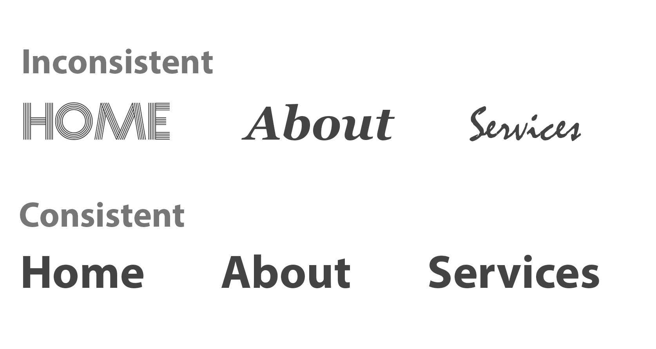

Slide 15
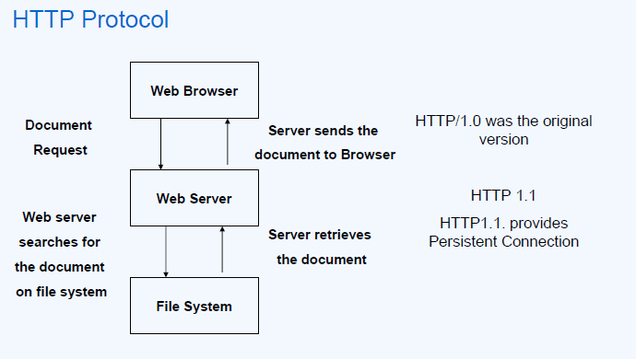

Slide 16
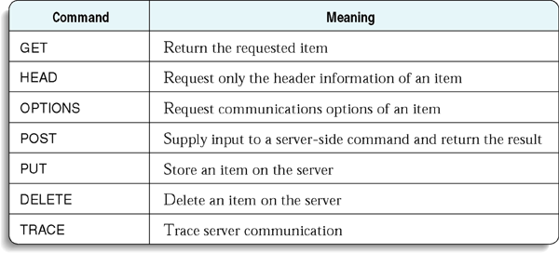
HTTP Commands
HTTP/1.1 200 OK
Allow: OPTIONS, GET, HEAD, POST
Cache-Control: max-age=604800
Date: Thu, 13 Oct 2016 11:45:00 GMT
Expires: Thu, 20 Oct 2016 11:45:00 GMT
Server: EOS (lax004/2813)
x-ec-custom-error: 1
Content-Length: 0
curl -X OPTIONS http://example.org -i

Slide 17
Static Pages / Dynamic Pages

Slide 18
SERVER
page.html page.html page.html
A static website is a group of self-contained,
individual pages (or page), sent to the browser from
the server one-page-at-a-time.

Slide 19
.net
_{SERVER} page.html
SQL databases
HTML
Dyamic web content is built when it is requested,
by the user directly, or programmatically while
a user is on a page (e.g., facebook updates).
Most websites contain both static and dynamic elements.

Slide 20
front-end
HTML
REQUEST ^{CSS} Javascript
Can I have ^{thanks!}
a webpage, please?
.net
SERVER
RESPONSE
back-end “recipe”
SERVER
SQL databases

Slide 21
Server-side / Client-side
aka
Back End / Front-end

Slide 22
^{.net} page.html
SERVER BROWSER
style.css
etc
script.js
Client-side (front-end) coding includes HTML, CSS
and Javascript. This just means that our code will be
downloaded from the server and then compiled
entirely in the browser.
.asp
SQL

Slide 23
HTML, CSS, Javascript

Slide 24
Three layers of web design:
Structure, Style, Behavior

Slide 25

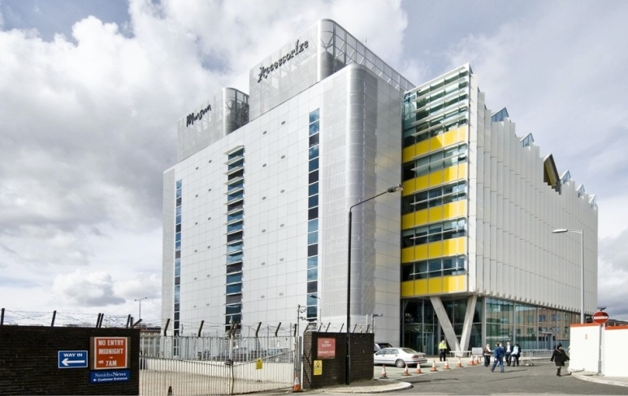
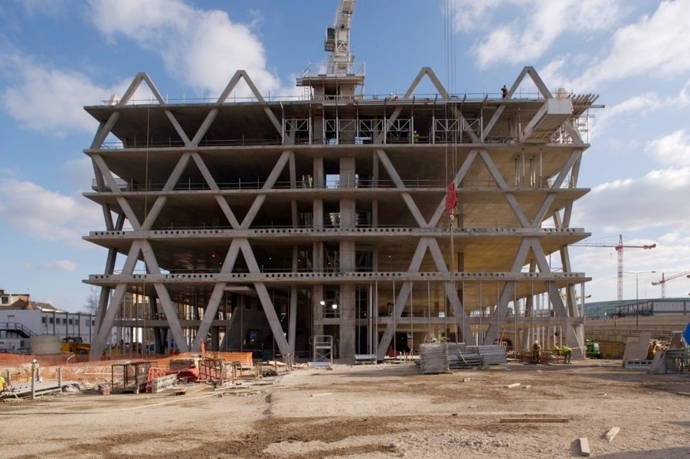
BEHAVIOR
Javascript
PRESENTATION
CSS
Imagery
STRUCTURE
HTML markup
Site planning

Slide 26
Difference Between HTTP &HTTPS
Sr.No | HTTP | HTTPs
1 | It is hypertext transfer protocol | It is hypertext transfer protocol with secure
2 | It is not secure & unreliable | It is secure and reliable
3 | HTTP URLs begin with http:// | HTTPs URLs begin with https://
4 | It uses port 80 for communication | It uses port 443 for communication
5 | Operates at Application Layer | Operates at Transport Layer
6 | No encryption &No certificates required | Encryption is present &certificate required

Slide 27
Difference Between HTML4 &HTML5
Sr.No | HTML4 | HTML5
1 | Doctype declaration in Html is too longer <!DOCTYPE HTML PUBLIC "-//W3C//DTD HTML 4.01//EN" "http://www.w3.org/TR/html4/strict.dtd"> | DOCTYPE declaration in Html5 is very simple "<!DOCTYPE html>
2 | character encoding in Html is also longer <!DOCTYPE HTML PUBLIC "-//W3C//DTD HTML 4.0 Transitional//EN"> | character encoding (charset) declaration is also very simple <meta charset="UTF-8">
3 | Audio and Video are not part of HTML4 | Audio and Videos are integral part of HTML5 e.g. <audio> and <video> tags.
4 | Vector Graphics is possible with the help of technologies such as VML, Silverlight, Flash etc | Vector graphics is integral part of HTML5 e.g. SVG and canvas
5 | Html5 use cookies. | It provides local storage in place of cookies.

Slide 28
Difference Between HTML4 &HTML5
Sr.No | HTML4 | HTML5
6 | It is almost impossible to get true GeoLocation of user browsing any website especially if it comes to mobile devices. | JS GeoLocation API in HTML5 helps identify location of user browsing any website (provided user allows it)
7 | to possible to draw shapes like circle, rectangle, triangle. | Using Html5 you can draw shapes like circle, rectangle, triangle.
8 | Does not allow JavaScript to run in browser. JS runs in same thread as browser interface. | Allows JavaScript to run in background. This is possible due to JS Web worker API in HTML5
9 | Works with all old browsers | Supported by all new browser.
10 | to possible to draw shapes like circle, rectangle, triangle. | Using Html5 you can draw shapes like circle, rectangle, triangle.

Slide 29
HTML-5
HTML stands for Hyper Text Markup Language.
HTML describes the structure of Web pages using markup.
Markup Language is a way of writing layout information within documents.
HTML elements are the building blocks of HTML pages .
HTML elements are represented by tags.
<!DOCTYPE html> is compulsory in HTML-5.
The default character encoding in HTML5 is UTF-8.

Slide 30
HTML-5
WYSIWYG Called as "What You See Is What You Get“.
HTML Editor :Notepad,TestEdit,Simple Text, NotePad ++, etc.
HTML editors (WYSIWYG Editors):Microsoft Front Page, Macromedia Dreamweaver,Netscape Composer, Microsoft Word, Visual Studio
HTML Extension: .htm or .html
Tim Berners-Lee invented HTML in 1991.
Html: Not case-Sensitive language.

Slide 31
HTML-5 Version
Version | Year
HTML | 1991
HTML 2.0 | 1995
HTML 3.2 | 1997
HTML 4.01 | 1999
XHTML | 2000
HTML5 | 2014

Slide 32
Page Structure of HTML
HTML header
<!DOCTYPE HTML>
<html>
Opening tag
<head>
<meta charset="UTF-8">
<title>My First HTML Page</title>
</head>
Closing tag
<body>
<p>This is some text...</p>
</body>
</html>
Only the content inside the <body> section (the green area above) is displayed in a browser.
HTML body

Slide 33
Page Structure of HTML
The <!DOCTYPE> declaration represents the document type, and helps browsers to display web pages correctly
The <!DOCTYPE html> declaration defines this document to be HTML5
The <html> element is the root element of an HTML page
The <head> element contains meta information about the document
The <title> element specifies a title for the document
The <body> element contains the visible page content
The <head> Section: Title, Meta, Script, Style

Slide 34
New HTML5 Elements
The most interesting new HTML5 elements are:
New semantic elements like <header>, <footer>, <article>, and <section>.
New attributes of form elements like number, date, time, calendar, and range.
New graphic elements: <svg> and <canvas>.
New multimedia elements: <audio> and <video>

Slide 35

Basic Tags of HTML
<!DOCTYPE html>
<html>
<head>
<Title> HTML5</title>
</head>
<Body>
This is my First Program</body>
</html>
<!DOCTYPE html>
<html>
<head>
<Title> HTML5</title>
</head>
<Body>
This is my First Program.
This is my second program.
This is my Third program.
</body>
</html>
Output:
Output:

Slide 36
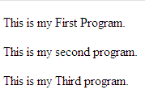
Basic Tags of HTML
<!DOCTYPE html>
<html>
<head>
<Title> HTML5</title>
</head>
<Body>
<p>This is my First Program </p></body>
</html>
<!DOCTYPE html>
<html>
<head>
<Title> HTML5</title>
</head>
<Body>
<p>This is my First Program.</p>
<p>This is my second program.</p>
<p>This is my Third program.</p>
</body>
</html>
Paragraph tag(paired tag)
Output:
Output:

Slide 37
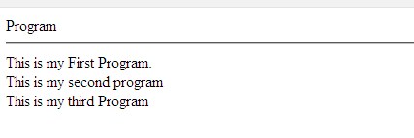
Basic Tags of HTML
<!DOCTYPE html>
<html>
<head>
<Title> HTML5</title>
</head>
<Body>
Program<hr>
This is my First Program.<br>
This is my second program</br>
This is my third Program
</body>
</html>
Hr:Horizantal Line tag (Unpaired tag) define like<hr> or <hr/>
Br:Break Line tag (Unpaired tag) define like<br> or <br/>
Output:

Slide 38
Header Tags
Header Tags -- Used for marking sections and subsections in a document.
<H1>Header 1 -- Giant-sized and bold </H1>
<H2>Header 2 -- Large and bold </H2>
<H3>Header 3 -- Normal-sized and bold </H3>
<H4>Header 4 -- Small and bold </H4>
<H5>Header 5 -- Very Small and bold </H5>
<H6>Header 6 -- Tiny and bold </H6>

Slide 39
Header Tags (cont.)
H1 = Giant-sized and bold
H2 = Large and bold
H3 = Normal-sized and bold
H4 = Small and bold
H5 = Very Small and bold
H6 = Tiny and bold

Slide 40
Breaking Lines and Paragraphs
<P> text </P>
Paragraph tag
Most browsers render (process) this with blank lines between each paragraph
<BR>
Line break tag
Used when the webmaster wants a carriage return but doesn't want a blank line to follow
Example: text a
<p>text a</p>
<p>text b</p> text b
<br>text c
<br>text d text c
text d

Slide 41
Horizontal Rule
The <HR> tag puts a graphical line across the page.
Ex:
Horizontal Rule Attributes:
NOSHADE -- A solid line with no shading
WIDTH="xx%/xx" -- Controls the width of the line. You may specify either percentage of the width of a page or actual pixel length
SIZE="xx" -- Controls the height of the line. You need to specify the
dimension in pixels.
ALIGN="left/center/right" -- This allows the line to be aligned to the left,
right, or center of the page

Slide 42
Text Formatting Tags
Some basic text formatting styles:
Tag Result
<I> Italics </I> Italics
<B> Bold </B> Bold
<PRE> Preformatted Text </PRE> Preformatted Text
<STRONG> Strong </STRONG> Strong
<ADDRESS> Address </ADDRESS> Address
<CITE> Citations </CITE> Citations
<CODE> Source Code </CODE> Source Code

Slide 43
Font modifications
Web creators can also change the way text looks by using the <FONT> tag
SIZE="number" - changes size of the font; 1=smallest, 7 = largest <FONT SIZE="7">Big</FONT> <FONT SIZE="1">Small</FONT>
Big Small
COLOR="color-name" - changes text color
<FONT COLOR="red">This is red</FONT>
This is red
FACE="font-name" - changes font
<FONT FACE="verdana">This is the verdana font;</FONT> <FONT FACE="chicago">this is the chicago font.</FONT>
This is the verdana font; this is chicago font.

Slide 44
<Font> modifications (cont.)
One can combine font modifications:
<FONT SIZE="7" FACE="courier" COLOR="red">Big, Courier & Red</FONT>
Big, Courier & Red
<FONT SIZE="7"><FONT FACE="courier">Big & Courier</FONT> - Just Big</FONT>
Big & Courier - Just Big

Slide 45
Lists -- Unordered Lists
Unordered lists:
<UL>
<LI>Item One
<LI>Item Two
<LI>Item Three
<LI>Item Four
</UL>
Item One
Item Two
Item Three
Item Four
Unordered List Attributes:
type="disc/circle/square"
Disc (default) ○ Circle  Square

Slide 46
Lists -- Ordered Lists
Ordered (Numbered) Lists:
Ordered List Attributes:
<OL>
<LI> Item One
<LI> Item Two
<LI> Item Three
<LI> Item Four
</OL>
1. Item One
2. Item Two
3. Item Three
4. Item Four
type="i/I/a/A/1" (default)
i = i. Item One I = I. Item One a = a. Item One A = A. Item One 1 = 1.Item One
ii. Item Two II. Item Two b. Item Two B. Item Two 2. Item Two
iii. Item Three III. Item Three c. Item Three C. Item Three 3. Item Three
iv. Item Four IV. Item Four d. Item Four D. Item Four 4. Item Four
start="xx"
This attribute lets you specify which number/letter will start the list

Slide 47
Lists -- Definition Lists
Definition Lists:
<DL>
<DT>List Name One
<DD>This is where information about List Name One would go</DD>
</DT>
<DT>List Name Two
<DD>This is where information about List Name Two would go</DD>
</DT>
</DL>
List Name One
This is where information about List Name One would go
List Name Two
This is where information about List Name Two would go

Slide 48
Links
The anchor tag <A> is used to link one document to another or from one part of a document to another part of the same document.
Basic Links:
<A HREF="http://www.stanford.edu/">Stanford University</A>
Inter-document Links:
<A HREF="#spot">Point to 'spot' in this document</A>
Defining a point in a document:
<A NAME="spot">Spot</A>
Email links:
<A HREF="mailto:someone@somehost.com">Email someone@somehost.com</A>
The target attribute can have one of the following values:
_blank :Opens the linked document in a new window or tab
_self : Opens the linked document in the same window/tab as it was clicked (this is default)
_parent - Opens the linked document in the parent frame
_top - Opens the linked document in the full body of the window
framename - Opens the linked document in a named frame

Slide 49
Graphics
To have a graphic appear on a webpage, web designers must to put the <IMG> tag in with the address where the graphic "lives":
<IMG SRC="http://www.someplace.com/images/fish.gif">
Graphics attributes:
alt="text": insert a description of the graphic for those who are using browsers that cannot process images (e.g., page readers for the blind)
width="xx/xx%": width in pixels/percentage
height="xx/xx%": height in pixels/percentage
border="xx": pixel length of the border surrounding the image.
hspace="xx": places a buffer of space horizontally around the image
vspace="xx": places a buffer of space vertically around the image
align="top/middle/bottom/right/left": aligns image in relation to the text (see next 2 slides)

Slide 50
Graphics (cont.)
<img src="http://www.someplace.com/images/fish.gif" align="top">All about Fish
<img src="http://www.someplace.com/images/fish.gif" align="middle">All about Fish
<img src="http://www.someplace.com/images/fish.gif" align="bottom">All about Fish
All about Fish
All about Fish
All about Fish

Slide 51
Graphics (cont.)
<img src="http://www.someplace.com/images/fish.gif" align="left">
<img src="http://www.someplace.com/images/fish.gif" align="right">

Slide 52
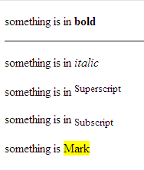
Basic Tags of HTML
<!DOCTYPE html>
<html>
<head>
<Title> HTML5</title>
</head>
<p>something is in <strong>bold</strong> </p> <hr/>
<!-- Check this is comment line.-->
<p>something is in <em>italic</em> </p>
<p>something is in <sup>Superscript</sup> </p>
<p>something is in <sub>Subscript</sub> </p>
<p>something is <Mark>Mark</sub> </Mark></p>
<Body>
</body>
</html>
Strong: Defines important text
<em> Renders as emphasized text
Sup: define superscripted text.
Sub: define subscripted text.
Mark:Highlight with Yellow color.
Output:

Slide 53
Heading Element
HTML headings are defined with the <h1> to <h6> tags.(All are paired tag)
<h7> to till infinity tag work as like paragraph.
<h1> headings should be used for main headings, followed by <h2> headings, then the less important <h3>, and so on.
Note: Use HTML headings for headings only. Don't use headings to make text BIG or bold or strong.

Slide 54
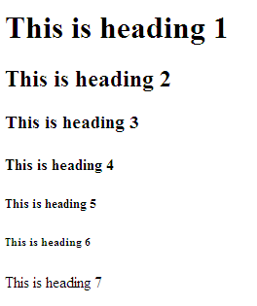
Heading Element
<!DOCTYPE html>
<html>
<body>
<h1>This is heading 1</h1>
<h2>This is heading 2</h2>
<h3>This is heading 3</h3>
<h4>This is heading 4</h4>
<h5>This is heading 5</h5>
<h6>This is heading 6</h6>
<h7> This is heading 7</h7>
</body>
</html>
Output:

Slide 55
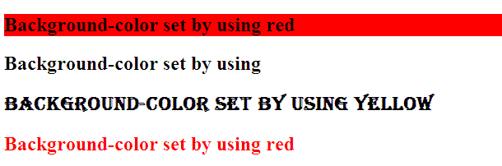
Heading Element
<!DOCTYPE html>
<html>
<body>
<h2 style="background-color: red"> Background-color set by using red</h2>
<h2 style=“font-size: 500 %"> Background-color set by using </h2>
<h2 style="font-family: Algerian">Background-color set by using yellow</h2>
<h2 style="color: red"> Background-color set by using red</h2>
</body>
</html>
Output:

Slide 56
Heading Element
All Font Tag in 1 program.
<!DOCTYPE html>
<html>
<body>
<h2 style="background-color: red; font-size: 500 %; font-family: Algerian; color:blue "> Background-color set by using red</h2>
</body>
</html>
Output:
OR (continue…)

Slide 57
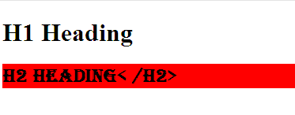
Heading Element
<!DOCTYPE html>
<html>
<head>
<style>
h2 {
background-color: red;font-size: 500 %;font-family:Algerian;
}
</style>
</head>
<body>
<h1 style=“color:blue”>H1 Heading </h1>
<h2 >H2 Heading< /h2>
</body>
</html>
Output:

Slide 58
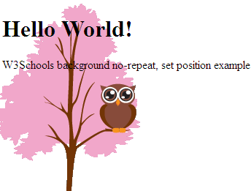
Body Tag
<!DOCTYPE html>
<html>
<head>
<style>
body {
background-image: url("img_tree.png");
background-repeat: no-repeat;
background-position: left top;
margin-right: 200px;
}
</style>
</head>
<body>
<h1>Hello World!</h1>
<p>W3Schools background no-repeat, set position example.</p>
</body>
</html>
Output:

Slide 59
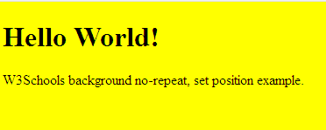
Body Tag
<!DOCTYPE html>
<html>
<head>
<Title> Body tag</title>
</head>
<body style="background-color:yellow;>
<h1>Hello World!</h1>
<p> W3Schoolbackground no-repeat, set position example.</p>
</body>
</html>
Output:

Slide 60
Anchor Tag
<a> anchor tag with attribute href.
The <a> tag defines a hyperlink, which is used to link from one page to another.
The most important attribute of the <a> element is the href attribute, which indicates the link's destination.
The target attribute can have one of the following values:
_blank :Opens the linked document in a new window or tab
_self : Opens the linked document in the same window/tab as it was clicked (this is default)
_parent - Opens the linked document in the parent frame
_top - Opens the linked document in the full body of the window
framename - Opens the linked document in a named frame

Slide 61
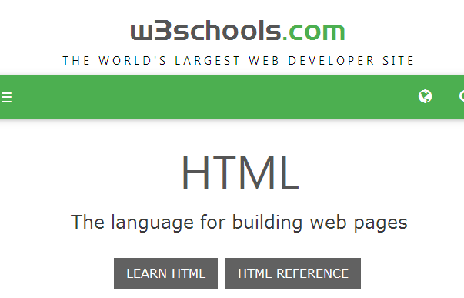

Anchor Tag
<a>:Anchor tag with attribute href( paired tag)
<!DOCTYPE html>
<html>
<body>
<a href = “https://www.w3schools.com” target="_top” >VisitW3Schools.com!</a>
</body>
</html>
Output:
After click on link output is as follows

Slide 62

Image Tag
The <img> or <IMAGE> tag defines an image in an HTML page.
It is paired as well as unpaired tag
The <img> tag has two required attributes: src and alt.
<!DOCTYPE html>
<html>
<body>
<img src="smiley.gif" alt="Smiley face" width="42" height="42">
</body>
</html>
src (source):attribute of image tag
Output:

Slide 63
Table Tag
An HTML table is defined with the <table> tag.
Each table row is defined with the <tr> tag.
A table header is defined with the <th> tag.
By default, table headings are bold and centered.
A table data/cell is defined with the <td> tag.
Rowspan and Colspan only used in <th> and <td> tag.
<th>,<td>,<tr> are paired as well as unpaired tag.
The <td> elements are the data containers of the table. They can contain all sorts of HTML elements; text, images, lists, other tables, etc.

Slide 64
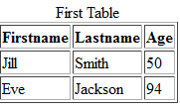
Table Tag
<!DOCTYPE html>
<html>
<body>
<table border=1>
<caption> table</caption>
<tr>
<th>Firstname</th>
<th>Lastname</th>
<th>Age</th>
</tr>
<tr>
<td>Jill</td>
<td>Smith</td>
<td>50</td>
</tr>
<tr>
<td>Eve</td>
<td>Jackson</td>
<td>94</td>
</tr>
</table>
</body>
</html>
Output:
Note: The <caption> tag must be inserted immediately after the <table> tag.

Slide 65
Table Tag
<!DOCTYPE html>
<html>
<body>
<h2>Cell that spans two columns:</h2>
<table border=1>
<tr>
<th>Name</th>
<th colspan="2">Telephone</th>
</tr>
<tr>
<td>Bill Gates</td>
<td>55577854</td>
<td>55577855</td>
</tr>
</table>
</body>
</html>
<!DOCTYPE html>
<html>
<body>
<h2>Cell that spans two columns:</h2>
<table border=1>
<tr>
<th>Name</th>
<th rowspan="2">Telephone</th>
</tr>
<tr>
<td>Bill Gates</td>
<td>55577854</td>
<td>55577855</td>
</tr>
</table>
</body>
</html>

Slide 66
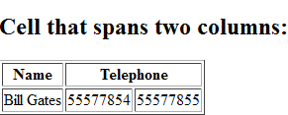
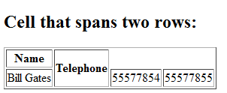
Table Tag
Output:

Slide 67
Table Tag
Use the HTML <table> element to define a table
Use the HTML <tr> element to define a table row
Use the HTML <td> element to define a table data
Use the HTML <th> element to define a table heading
Use the HTML <caption> element to define a table caption
Use the CSS border property to define a border
Use the CSS border-collapse property to collapse cell borders
Use the CSS padding property to add padding to cells
Use the CSS text-align property to align cell text
Use the CSS border-spacing property to set the spacing between cells
Use the colspan attribute to make a cell span many columns
Use the rowspan attribute to make a cell span many rows
Use the id attribute to uniquely define one table

Slide 68
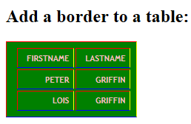
Table Tag
<!DOCTYPE html>
<html>
<head>
<style>
table, th, td {
border: 1px solid black;
border-color:red;
background-color:green;
text-align:right;
text-transform: uppercase;
padding: 6px 6px 6px 12px;
font: bold 11px "Verdana, Arial, Helvetica, sans-serif;
color: pink;
border-right: 1px solid yellow;
border-bottom: 1px solid blue;
}
</style>
</head>
<body>
<h2>Add a border to a table:</h2>
<table style= "">
<tr>
<th>Firstname</th>
<th>Lastname</th>
</tr>
<tr>
<td>Peter</td>
<td>Griffin</td>
</tr>
<tr>
<td>Lois</td>
<td>Griffin</td>
</tr>
</table>
</body>
</html>

Slide 69
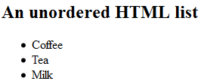
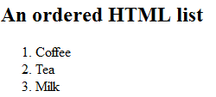
List Tag
An unordered list starts with the <ul> tag.
Each list item starts with the <li> tag.
An ordered list starts with the <ol> tag.
The unordered list items will be marked with bullets (small black circles) by default:
The ordered list items will be marked with numbers by default:
List can be nested.
<!DOCTYPE html>
<html>
<body>
<h2>An unordered HTML list</h2>
<ul>
<li>Coffee</li>
<li>Tea</li>
<li>Milk</li>
</ul>
</body>
</html>
<!DOCTYPE html>
<html>
<body>
<h2>An ordered HTML list</h2>
<ol>
<li>Coffee</li>
<li>Tea</li>
<li>Milk</li>
</ol>
</body>
</html>

Slide 70
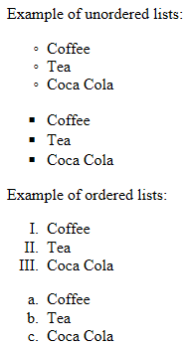
List Tag
!DOCTYPE html>
<html>
<head>
<style>
ul.a {list-style-type: circle;}
ul.b {list-style-type: square;}
ol.c {list-style-type: upper-roman;}
ol.d {list-style-type: lower-alpha;}
</style>
</head>
<body>
<p>Example of unordered lists:</p>
<ul class="a">
<li>Coffee</li>
<li>Tea</li>
<li>Coca Cola</li>
</ul>
<ul class="b">
<li>Coffee</li>
<li>Tea</li>
<li>Coca Cola</li>
</ul>
<p>Example of ordered lists:</p>
<ol class="c">
<li>Coffee</li>
<li>Tea</li>
<li>Coca Cola</li>
</ol>
<ol class="d">
<li>Coffee</li>
<li>Tea</li>
<li>Coca Cola</li>
</ol>
</body>
</html>

Slide 71
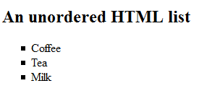
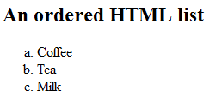
List Tag
<!DOCTYPE html>
<html>
<body>
<h2>Unordered List with Square Bullets</h2>
<ul style="list-style-type:square">
<li>Coffee</li>
<li>Tea</li>
<li>Milk</li>
</ul>
</body>
</html>
<!DOCTYPE html>
<html>
<body>
<h2>Unordered List with Square Bullets</h2>
<ol style="list-style-type:lower-alpha">
<li>Coffee</li>
<li>Tea</li>
<li>Milk</li>
</ul>
</body>
</html>

Slide 72
Form,Option,Textarea,Checkbox,Radio Tag
<!DOCTYPE html>
<html>
<body>
<form action=“List.html”>
First name:<br>
<input type="text" name="firstname">
<br>
Last name:<br>
<input type="text" name="lastname">
<br><br>
<select name="cars">
<option value="volvo">Volvo</option>
<option value="saab">Saab</option>
<option value="fiat">Fiat</option>
<option value="audi">Audi</option>
</select>
<br><br>
<<input type="checkbox" name="vehicle1" value="Bike">I have a bike
<br>
<input type="checkbox" name="vehicle2" value="Car">I have a car
<br><br>
<input type="radio" name="vehicle1" value="Bike">I have a bike
<br>
<input type="radio" name="vehicle2" value="Car">I have a car
<br><br>
<input type="submit">
</form>
<p>Note that the form itself is not visible.</p>
<p>Also note that the default width of a text field is 20 characters.</p>
</body>
</html>

Slide 73
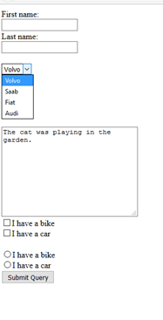
Output:

Slide 74
Tag
Sr.No | Tag | Description
1 | <dl> | Defines a description list
2 | <dt> | Defines a term in a description list
3 | <dd> | Describes the term in a description list
4 | <del> | Deleted text
5 | <ins> | Inserted text
6 | <q> | Defines a short quotation.
7 | <iframe> | Defines an inline frame
8 | <figcaption> | Defines a caption for a <figure> element

Slide 75
Tag
Sr.No | Tag | Description
9 | <footer> | Defines a footer for the document or a section
10 | <header> | Defines a header for the document or a section
11 | <time> | Defines a date/time
12 | <div> | defines a division or a section in an HTML document.
13 | <datalist> | Define a list of pre-defined options for an <input> element.
14 | <keygen> | Definespecifies a key-pair generator field used for forms.The keygen tag is not supported in Internet Explorer
15 | <optgroup> | used to group related options in a drop-down list.
16 | <video> | specifies video, such as a movie clip or other video streams.

Slide 76
Important Points
There are 3 supported video formats for the <video> element: MP4, WebM, and Ogg.
Default Color of active link is red.
The visited link in Mozilla Firefox & Google Chrome is generally shown in purple color.
The visited link in Internet Explorer is generally shown in blue color
The style and color of unvisited link in any browser is underline and blue.
Target attribute is used to specify where to open the linked document.

Slide 77
MCQS
1.What is internet? a) a single network b) a vast collection of different networks c) interconnection of local area networks d) none of the mentioned
2.Which one of the following protocol is not used in internet? a) HTTP b) DHCP c) DNS d) none of the mentioned
3 .The Internet was originally a project of which agency?
ARPA B. NSF C. NSA D. None of these
4. The computer jargon - WWWW, stands for :
A. World Wide Web Worm B. World Wide Wildlife Web
C. World Wide Women's Web D. World Wide Women's Week
5. The common element which describe the web page, is ?
A.heading B. Paragraph C. List D. All of these
6. HTML stands for?
A.Hyper Text Markup Language B.High Text Markup Language
C.Hyper Tabular Markup Language D.None of these
7.which of the following tag is used to mark a begining of paragraph ?
A.<TD> B.<br> C. <P> D. <TR>

Slide 78
MCQS
1.What is internet? a) a single network b) a vast collection of different networks c) interconnection of local area networks d) none of the mentioned
2.Which one of the following protocol is not used in internet? a) HTTP b) DHCP c) DNS d) none of the mentioned
3 .The Internet was originally a project of which agency?
ARPA B. NSF C. NSA D. None of these
4. The computer jargon - WWWW, stands for :
A. World Wide Web Worm B. World Wide Wildlife Web
C. World Wide Women's Web D. World Wide Women's Week
5. The common element which describe the web page, is ?
A.heading B. Paragraph C. List D. All of these
6. HTML stands for?
A.Hyper Text Markup Language B.High Text Markup Language
C.Hyper Tabular Markup Language D.None of these
7.which of the following tag is used to mark a begining of paragraph ?
A.<TD> B.<br> C. <P> D. <TR>

Slide 79
MCQS
8. Correct HTML tag for the largest heading is
A.<head> B. <h6> C. <heading> D. <h1>
9: Markup tags tell the web browser
A.How to organise the page B.How to display the page
C.How to display message box on page D.None of these
10: www is based on which model?
A.Local-server B. Client-server C. 3-tier D. None of these
11: What are Empty elements and is it valid?
A.No, there is no such terms as Empty Element
B.Empty elements are element with no data
C.No, it is not valid to use Empty Element
D. None of these
12: Which of the following attributes of text box control allow to limit the maximum
character?
A.size B. Len C.maxlength D. all of these

Slide 80
MCQS
8. Correct HTML tag for the largest heading is
A.<head> B. <h6> C. <heading> D. <h1>
9: Markup tags tell the web browser
A.How to organise the page B.How to display the page
C.How to display message box on page D.None of these
10: www is based on which model?
A.Local-server B. Client-server C. 3-tier D. None of these
11: What are Empty elements and is it valid?
A.No, there is no such terms as Empty Element
B.Empty elements are element with no data
C.No, it is not valid to use Empty Element
D. None of these
12: Which of the following attributes of text box control allow to limit the maximum
character?
A.size B. Len C.maxlength D. all of these

Slide 81
MCQS
13.HTML is a subset of
A.SGMT B. SGML C. SGMD D.None of these
14.Character encoding is
A.method used to represent numbers in a character
B.method used to represent character in a number
C.a system that consists of a code which pairs each character with a pattern,sequence of natural numbers or electrical pulse in order to transmit the data
D.none of these
15.Correct HTML to left align the content inside a table cell is
A.<tdleft> B. <td raligh = "left" > C.<td align = "left"> D. <td leftalign>
16.The tag which allows you to rest other HTML tags within the description is
A.<TH> B. <TD> C. <TR> D.<CAPTION>
17.How can you open a link in a new browser window?
A.< a href = "url" target = "new"> B. <a href = "url" target= "-blank">
C.<a href = "url".new> D. <a href = "url" target ="open">
18.The tag used to create a new list item and also include a hyperlink is
A.<LI> B. <DL> C.<DD> D. <UL>

Slide 82
MCQS
13.HTML is a subset of
A.SGMT B. SGML C. SGMD D.None of these
14.Character encoding is
A.method used to represent numbers in a character
B.method used to represent character in a number
C.a system that consists of a code which pairs each character with a pattern,sequence of natural numbers or electrical pulse in order to transmit the data
D.none of these
15.Correct HTML to left align the content inside a table cell is
A.<tdleft> B. <td raligh = "left" > C.<td align = "left"> D. <td leftalign>
16.The tag which allows you to rest other HTML tags within the description is
A.<TH> B. <TD> C. <TR> D.<CAPTION>
17.How can you open a link in a new browser window?
A.< a href = "url" target = "new"> B. <a href = "url" target= "-blank">
C.<a href = "url".new> D. <a href = "url" target ="open">
18.The tag used to create a new list item and also include a hyperlink is
A.<LI> B. <DL> C.<DD> D. <UL>

Slide 83
MCQS
19.<INPUT> is
A.format tag B. empty tag C.both (a) and (b) D. none of these
20.What i s the correct HTML for adding a background color?
A.<background>yellow<Background> B. <body color = "yellow">
C.<body bg color = "yellow"> D. <body bg ="yellow">
21. Main container for <TR>, <TD> and <TH> is
A.<TABLE> B. <GROUP> C. <DATA> D.All of these
22. How can you make an e-mail link?
A.<mail href +"xxx@y.com"> B. <a href ="mail to: xxx@y.com">
C.<a href = "xxx@y.com"> D. Both (b) and (c)
23. The web standard allows programmers on many different computer platforms to dispersed format and display the information server. These programs are called ____ Ans: Web Browser
24. We can write HTML Code using ______. Select appropriate option(s).
A.Notepad B.Microsoft word C.both a&b D.vlc media
25. HTML program is saved using ____________ extension.
A. .hml B. .htnl C. .htl D. .html

Slide 84
MCQS
19.<INPUT> is
A.format tag B. empty tag C.both (a) and (b) D. none of these
20.What i s the correct HTML for adding a background color?
A.<background>yellow<Background> B. <body color = "yellow">
C.<body bg color = "yellow"> D. <body bg ="yellow">
21. Main container for <TR>, <TD> and <TH> is
A.<TABLE> B. <GROUP> C. <DATA> D.All of these
22. How can you make an e-mail link?
A.<mail href +"xxx@y.com"> B. <a href ="mail to: xxx@y.com">
C.<a href = "xxx@y.com"> D. Both (b) and (c)
23. The web standard allows programmers on many different computer platforms to dispersed format and display the information server. These programs are called ____ Ans: Web Browser
24. We can write HTML Code using ______. Select appropriate option(s).
A.Notepad B.Microsoft word C.both a&b D.vlc media
25. HTML program is saved using ____________ extension.
A. .hml B. .htnl C. .htl D. .html

Slide 85
MCQS
26. Who was the primary author of HTML (Hyper Text Markup Language). ?
A. Brendan Eich B. Tim Berners-Lee C. Google Inc. D. Sabir Bhatiya
27. .................. is suitable for remote administration of a computer.
A) FTP` B) Shell C) Remote Procedure Call D) Telnet
28. Title tag is nested within the .......................tag.
Body B) Head C) List D) Table
29.The purpose of Markup is to
A. Add hypertext capabilities B. Enhance the document
C. Both A and B D.None of the above
30.width=”100px” and width=”100%” the same?
A. No B. Yes
31.What are <div> tags used for?
A. To replace paragraphs. i.e. p tags B.to logically divide the paragraphs
C.To logically divide the document D.To provide space between tables
32What is the attribute for <image> tag?
A. Pt B. url C. Path D. src

Slide 86
MCQS
33. Which of the following feature is a part of HTML 5?
A Canvas B - Audio & Video C - Geolocation D - All of the above.
34.HTML is governed by who?
A. The Microsoft Corporation. B. The Google Corporation.
C. The World Wide Web Consortium (W3C).
D. The United Nations committee on Telecommunications Ans. C
35.HTML5 browswers will support the following new technology.
CSS 2 B. PDF 10.2 C. Macromedia Flash D. CSS 3
36.Following code is used for
<video width=“320″ height=“240″ controls=“controls”>
<source src=“test.mp4″ type=“video/mp4″ /> </video>
display audio B.display video C. display text D.display image
37.Which among the following tags define a caption for a <fieldset> element?
A) <select> B) <label> C) <legend> D) <textarea>

Slide 87
MCQS
38.ISP Stands for internet Service provider.
39.HTTP stands for Hypertext Transfer protocol.
40.URL stands for uniform Resource Locator.
41.The link in Html is of type
a.Visited b.Active c.Unvisited d.All of the Above
42.Default color of active link is
a.Red b.green c.blue d.magenta
43.The attribute that define the relationship between current document and hrefed URL is ____
a.Rel b.url c.rev d.All
44.If image is can not be displayed then ____ specifies an alternate text for an image.
a.Text attribute b.value attribute c.alt atrribute d.none
45.In Image tag <img src=“TajMahal.jpg”> the “TajMahal.jpg” is_____
a.Element b.attribute c.Value d.None
46.When creating a web document, what format is used to express an image’s height and width?
a.Centimeter b.pixel c.dots per inch d.None

Slide 88
MCQS
47. The default character encoding in HTML5 is. A) UTF-16 B) UTF-32 C) UTF-8 D) ISO-8859-1
48. How many new form elements are introduced in HTML5? A) 6 B) 4 C) 3 D) 2
49. Which tag creates a check box for a form in HTML? a. <checkbox> b. <input type="checkbox"> c. <input=checkbox> d. <input checkbox>
50. Inline elements are normally displayed without starting a new line.(T/F)
Ans.True
51. Correct way to declaring character encoding in html5 is:
A. <meta http-equiv="Content-Type" content="text/html; charset=UTF-8" />
B. <meta http-equiv="Content-Type" charset=UTF-8" />
C. <meta http-equiv="Content-Type" content="text/html;/>
D. <meta content="text/html; charset=UTF-8" />
E. <meta charset="UTF-8" />
52.Which of the following is HTML layout tag?
a.<a> b.<meta> c.<div> d.<script>
53.CSS stands for Cascading Style Sheet.

Slide 89
MCQS
47. The default character encoding in HTML5 is. A) UTF-16 B) UTF-32 C) UTF-8 D) ISO-8859-1
48. How many new form elements are introduced in HTML5? A) 6 B) 4 C) 3 D) 2
49. Which tag creates a check box for a form in HTML? a. <checkbox> b. <input type="checkbox"> c. <input=checkbox> d. <input checkbox>
50. Inline elements are normally displayed without starting a new line.(T/F)
Ans.True
51. Correct way to declaring character encoding in html5 is:
A. <meta http-equiv="Content-Type" content="text/html; charset=UTF-8" />
B. <meta http-equiv="Content-Type" charset=UTF-8" />
C. <meta http-equiv="Content-Type" content="text/html;/>
D. <meta content="text/html; charset=UTF-8" />
E. <meta charset="UTF-8" />
52.Which of the following is HTML layout tag?
a.<a> b.<meta> c.<div> d.<script>
53.CSS stands for Cascading Style Sheet.

Slide 90
Thank You

